Slide 1
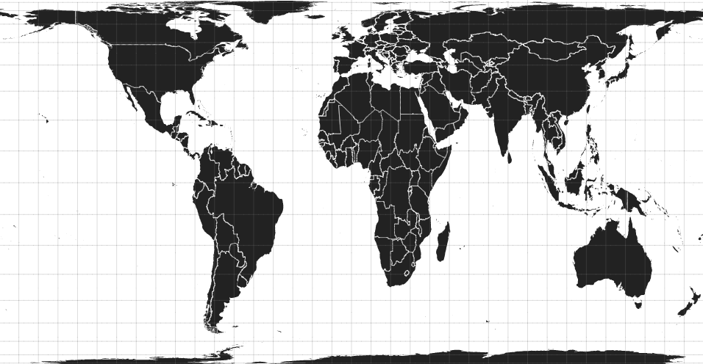
Speaking from the Semi-Periphery:
Decolonizing Geographical
Knowledge Production in Socialist Hungary
1960s–1980s
Zoltán GINELLI
zginelli@gmail.com
PhD Candidate
Doctoral School of Earth Sciences
Eötvös Loránd University
Assistant Researcher
1989 after 1989: Rethinking the
Fall of State Socialism in a Global Perspective (Exeter University)
University College London, School of Slavonic and East European Studies | 28 March 2017

Slide 2
PART 1
Research Proposal and Contribution
University College London, School of Slavonic and East European Studies | 28 March 2017

Slide 3

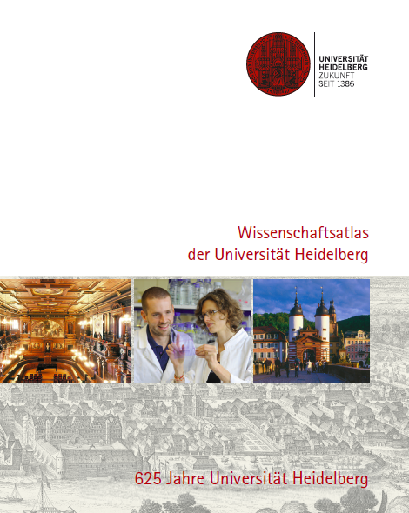


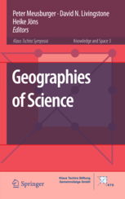

The Historical Geographies of Scientific Knowledge
Livingstone, D. N. (2003): Putting Science in its Place
Wissenschaftsatlas of Heidelberg University (2011)
Knowledge & Space series (2006-)
1
University College London, School of Slavonic and East European Studies | 28 March 2017

Slide 4


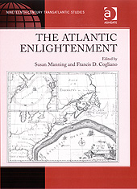


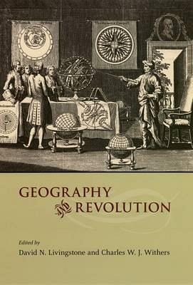
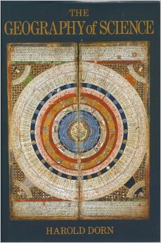


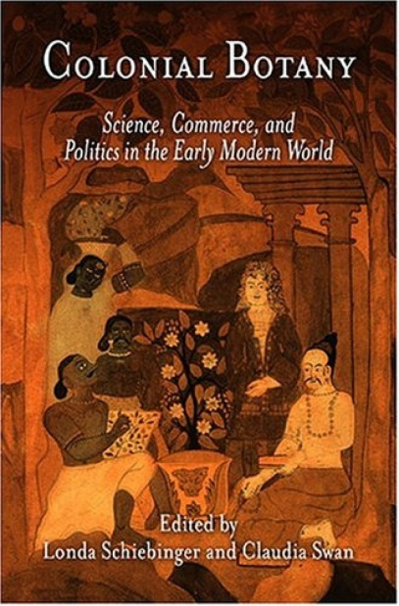
2
University College London, School of Slavonic and East European Studies | 28 March 2017

Slide 5
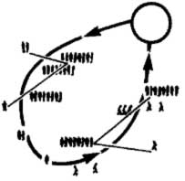
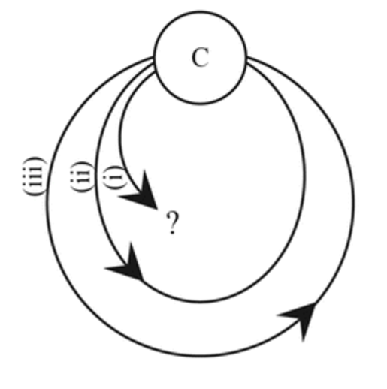
Following the circulations of scientific knowledge
Going away
Crossing other people’s path
Coming back
Centres of calculation
Latour, B. (1987): Science in Action: How to Follow Scientists and Engineers through Society. Harvard University Press, Cambridge (MA), p. 211.
McCann, E. (2011): Urban Policy Mobilities and Global Circuits of Knowledge: Toward a Research Agenda. Annals of the Association of American Geographers, 101(1): 107–130.
3
University College London, School of Slavonic and East European Studies | 28 March 2017

Slide 6
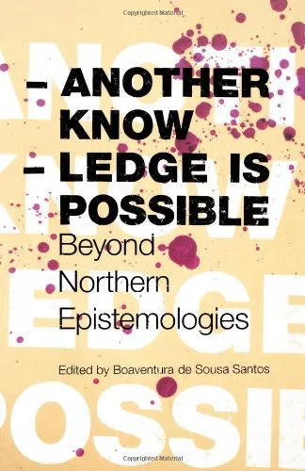
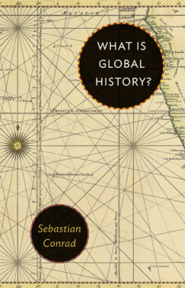
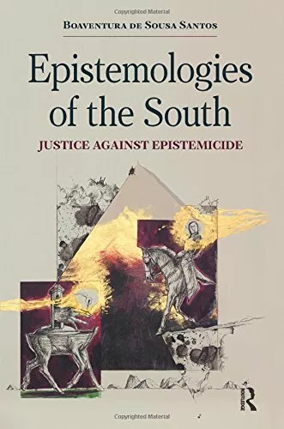

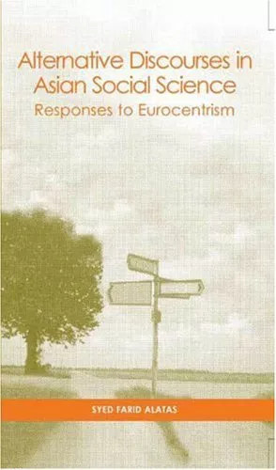
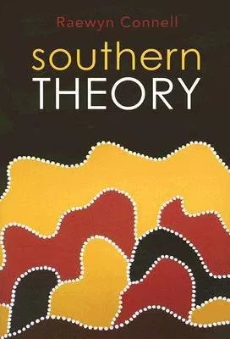
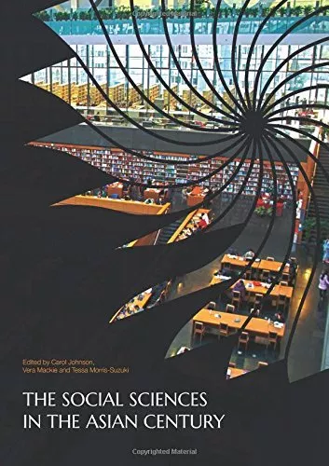
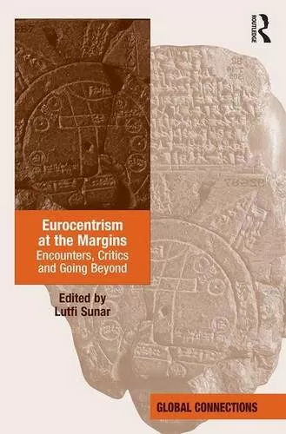
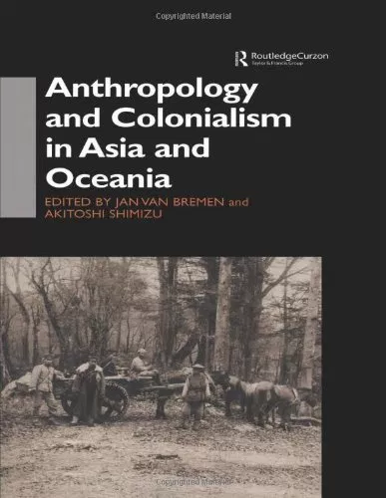
4
University College London, School of Slavonic and East European Studies | 28 March 2017

Slide 7
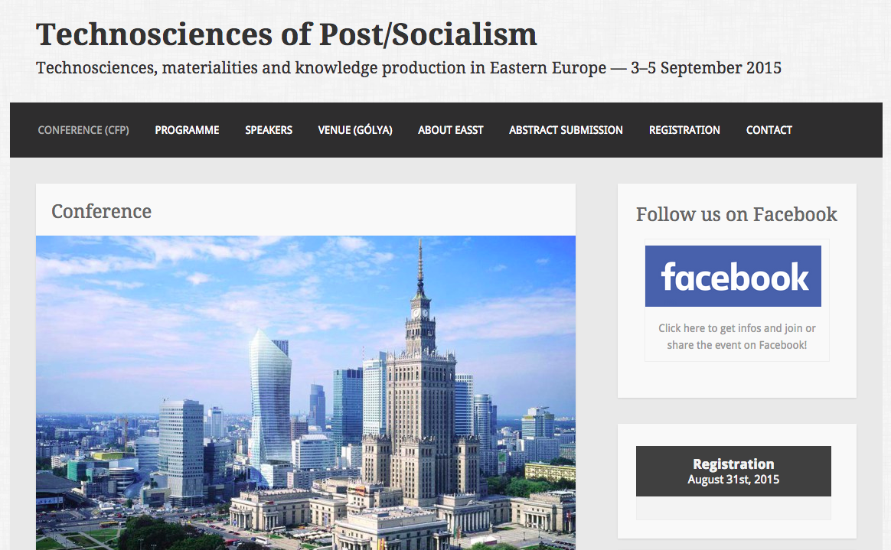
5
2
University College London, School of Slavonic and East European Studies | 28 March 2017

Slide 8
The Question?
How certain intellectual elites in socialist Hungary tried to reimagine their country’s position in its integration to the world economy?
“Socialist Globalisation,” “Other Globalisers”
(Mark and Apor 2014; Bockman 2015; Bockman, Feygin and Mark forthcoming)
  Hungary as “open economy” in the world economic system, export-oriented growth, foreign trade, efficiency, selective profile industrialization – maneuvering between economic crises and geopolitical pressures
  Various geographical imaginations apart from socialist and capitalist world-systems: “semi-periphery,” “small countries,” “open economy,” “interdependency”
  Seeking international development models, comparisons:
  East Asian “Tigers” (South Korea), Spain, Chile, etc.
6
University College London, School of Slavonic and East European Studies | 28 March 2017

Slide 9
Contribution of Research
Theoretical background
  Anti-Euro/Westcentric literature, post/decolonial theory
  Connecting political economic and poststructuralist perspectives: structures of world-systemic hegemonies and emergent circulatory networks
Thinking between Cold War dichotomies
  Market-oriented, neoliberal roots of reform socialism
  (Bockman 2011)
Rethinking the histories of postwar globalisation by focusing on socialist and non-aligned world
  Eastern European development trajectories, case study of researchers at Hungarian research institute HAS CAAR/IWE
7
University College London, School of Slavonic and East European Studies | 28 March 2017

Slide 10

Hungary
CAAR
Kwame Nkrumah
Visit to USSR and Eastern Europe, Hungary
Seven-Year Plan (1964)
Hungarian economists, József Bognár
Tamás Szentes
Dept. Head (1967–1971)
Influential Leftist hub
‘Third Way’ development
Ghana
Tanzania
Dar-es-Salaam
8
University College London, School of Slavonic and East European Studies | 28 March 2017

Slide 11
Archival and oral history research
Archives (Budapest):
National Archives: National Planning Office, Committee for International Economic Relations
National Archives: Ministry of Foreign Affairs
Archives of the Hungarian Academy of Sciences (HAS)
Karl Marx University of Economics, Department/Institute for World Economy
International: UNCTAD (Geneva), Accra (Ghana)
Oral History (ca. 20–30 ppl):
Research staff of the (HAS) Centre for Afro-Asian Studies / Institute for World Economy [József Bognár]
Researchers connected to Area Studies and International Relations
Researchers connected to foreign policy-making
9
University College London, School of Slavonic and East European Studies | 28 March 2017

Slide 12
So… is this just about socialist history?
…wait, there’s much more!
10
University College London, School of Slavonic and East European Studies | 28 March 2017

Slide 13
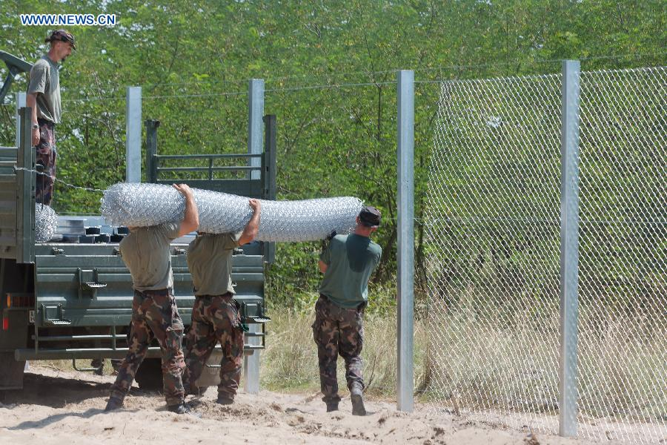

So is this just about socialist history?
11
University College London, School of Slavonic and East European Studies | 28 March 2017

Slide 14
12
University College London, School of Slavonic and East European Studies | 28 March 2017

Slide 15
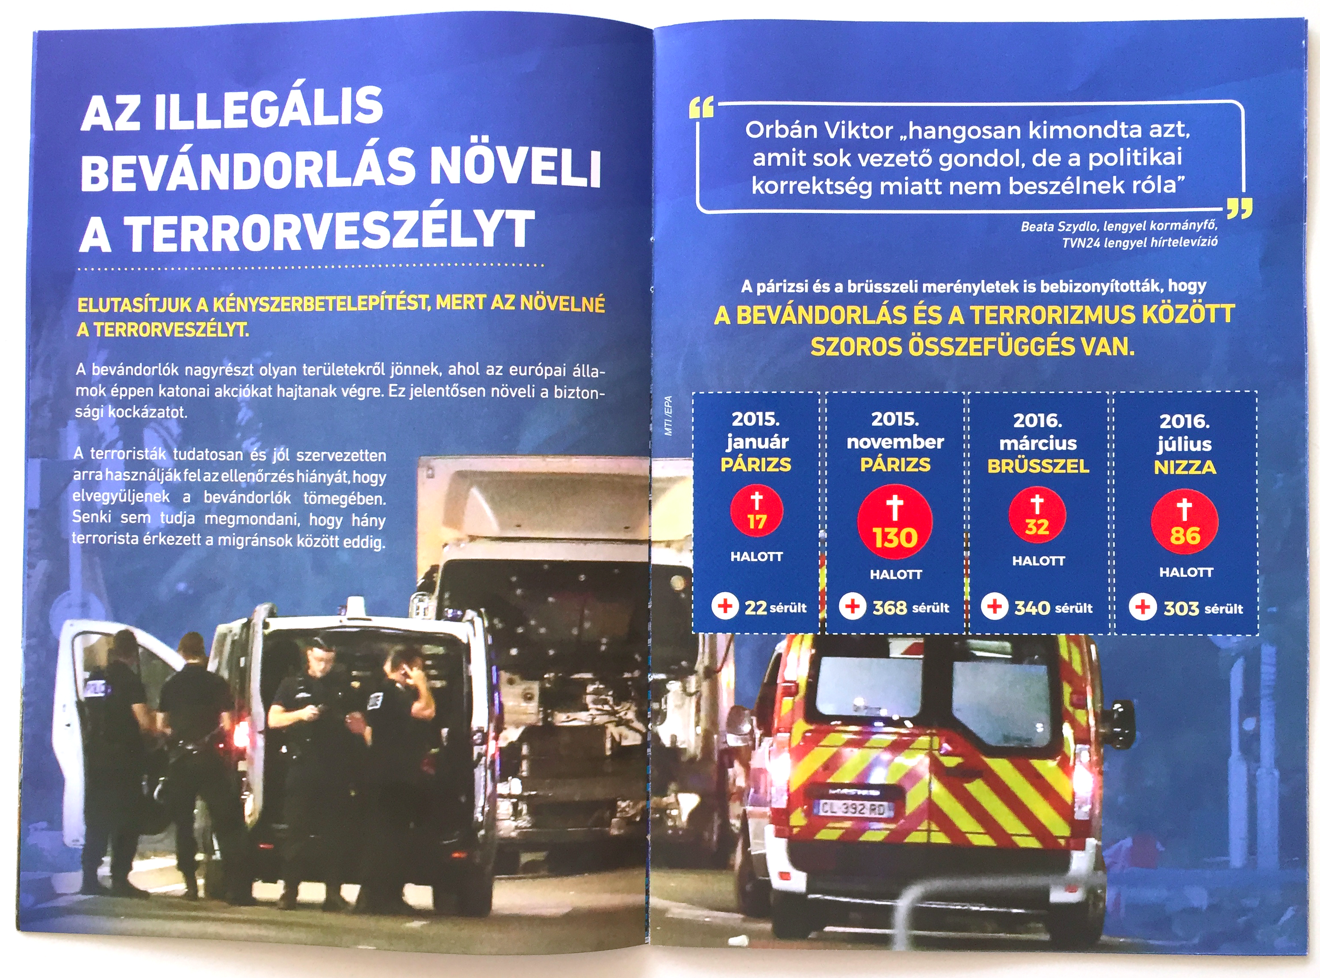
So is this just about socialist history?
3
13
University College London, School of Slavonic and East European Studies | 28 March 2017
Notes:
Also interesting in light of the recent migration crisis, in which Hungary in language reaching back to the Trianon trauma of “defending the national borders”

Slide 16
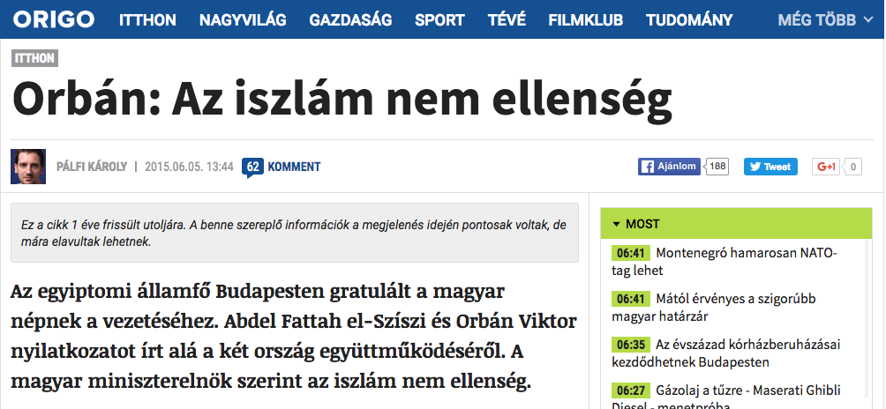
14
University College London, School of Slavonic and East European Studies | 28 March 2017

Slide 17
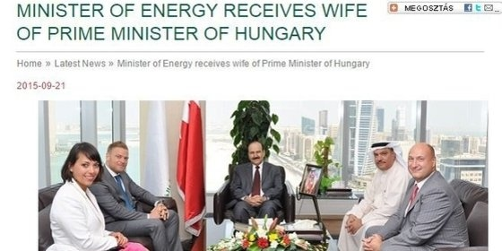
15
University College London, School of Slavonic and East European Studies | 28 March 2017

Slide 18
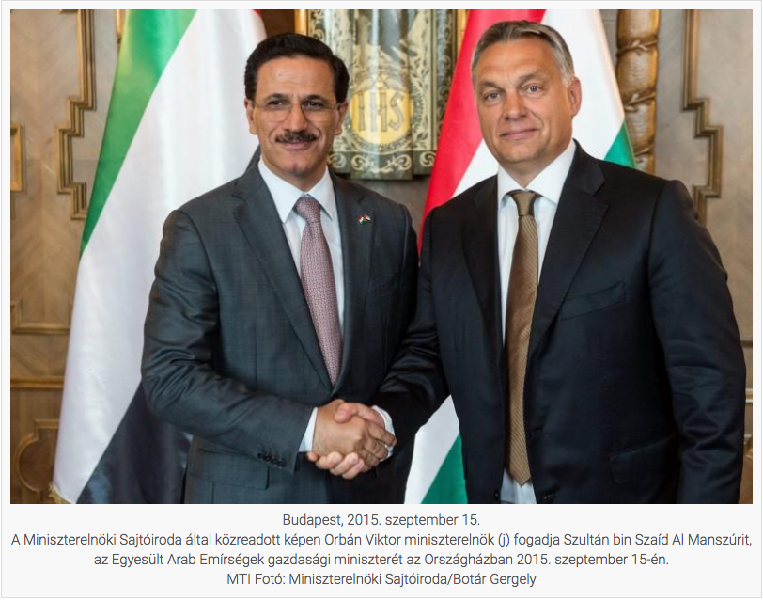
16
3
University College London, School of Slavonic and East European Studies | 28 March 2017

Slide 19
So is this just about socialist history?
FIDESZ government: “global opening” since 2010
Interview with Péter Wintermantel, newly assigned under-secretary of global affairs in the Ministry of Foreign Affairs:
  “It is an important goal for the Hungarian economy to return to those regions, in which it was intensively present in former times, such as the Arab world, Africa or South East Asia. … He recalled: previously ten thousands of students coming from developing countries studied in Hungary, which had a huge impact on building bilateral agreements. It would be great to again take advantage of these opportunities.” (19 July 2013)
Source: http://2010-2014.kormany.hu/hu/kulugyminiszterium/globalis-ugyekert-felelos-helyettes-allamtitkarsag/hirek/a-globalis-nyitas-sikeres-politikajat-folytatna-a-kum-uj-helyettes-allamtitkara
17
University College London, School of Slavonic and East European Studies | 28 March 2017

Slide 20
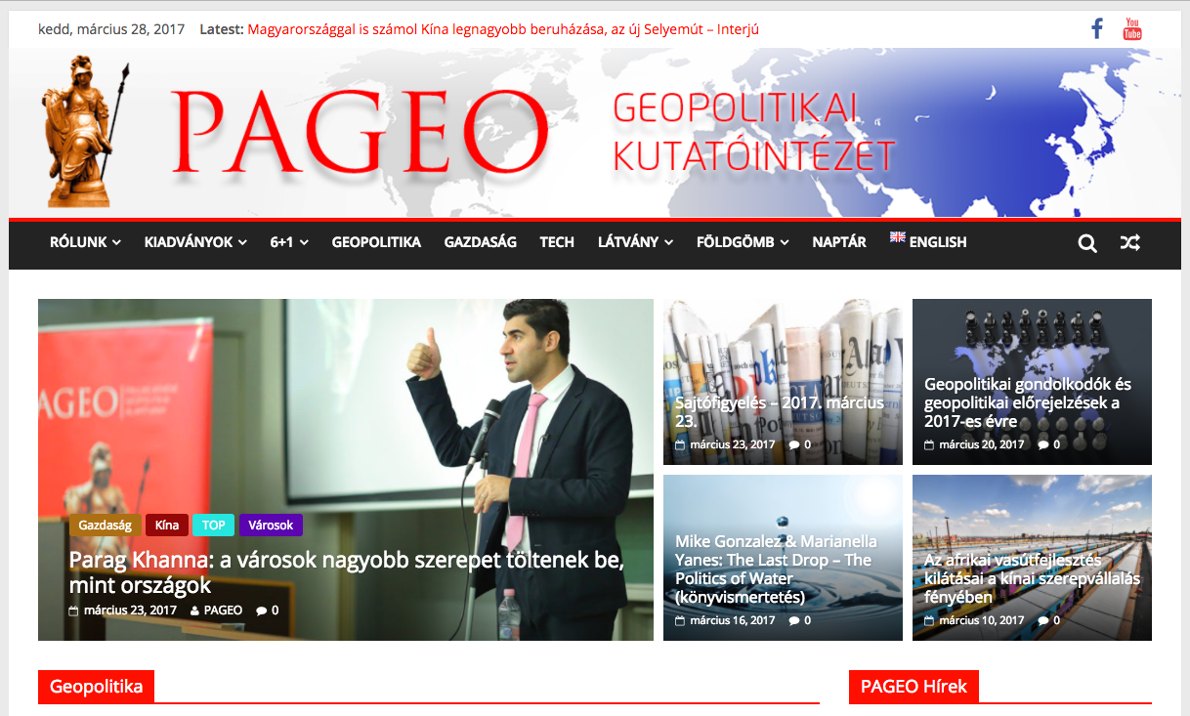
18
University College London, School of Slavonic and East European Studies | 28 March 2017

Slide 21
PART 2
Critical Area Studies
University College London, School of Slavonic and East European Studies | 28 March 2017

Slide 22
Decolonizing Eastern Europe
Critical Geopolitics and decolonizing Area Studies
(Agnew 1990; Dalby 1990; Ó Tuathail 1988; Böröcz 2009; Cairo 2010; Hobson 2012)
Understanding transnational histories and mapping alternative geographical conceptualizations, the various actors and rivaling geographical imaginaries
Historically constructed East/West “civilizational slope”
(Wolff 1994; Melegh 2006)
Postcolonialism, -socialism: theorizing between the “posts”
Speaking from the semi-periphery:
Concealment of Second-Third World relations
The interdependency of centre and periphery in interconnected global relations
1
University College London, School of Slavonic and East European Studies | 28 March 2017

Slide 23
Teaching Critical Area Studies
Proposed (Optional) Courses:
Approaches to Human Geography
Lecture following HGSK perspective to deconstruct mainstream Anglo-American textbook narratives, and show the international discourse, interconnections and geographical differences in the construction of epistemological approaches based on their local social histories.
Global Histories of Knowledge
Workshop-like seminar overviewing the global hegemonic shifts of knowledge production, the various actors in circulatory networks, the “globalization” of theories and the shifting imaginaries of areas.
Decolonizing Eastern Europe
Reading seminar deconstructing the mainstream narratives on Eastern European development, the self-Orientalizing construction of the region, and its alternative globalizing ambitions deciphered “from below.”
2
University College London, School of Slavonic and East European Studies | 28 March 2017

Slide 24
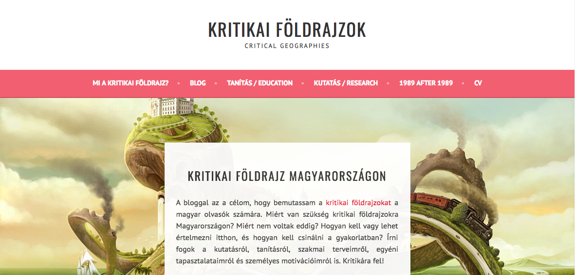
Networking and community
Proposed Conference/Workshop:
Decolonizing Eastern European Social Sciences
Region-specific (trans)disciplinary histories
Global perspective and international interconnectedness
Post/Colonial heritage of Eastern Europe
Critical analysis of knowledge hegemony and self-Orientalizing practices
Personal blog
3
University College London, School of Slavonic and East European Studies | 28 March 2017

Slide 25
Email: zginelli@gmail.com
Blog: https://kritikaifoldrajz.hu
Academia.edu: https://elte.academia.edu/Zolt%C3%A1nGyimesi
Researchgate: https://www.researchgate.net/profile/Zoltan_Ginelli2
LinkedIn: https://www.linkedin.com/in/zolt%C3%A1n-ginelli-42bb5a134
Zoltán
GINELLI
University College London, School of Slavonic and East European Studies | 28 March 2017

